Slide 1
Hackathon 2019

Slide 2
Health, safety, environment, compliance, and quality are the personal responsibility of every employee.
Notes:
Although our brand and visual identity has changed, our commitment to our foundation remains unshakable. We are committed to health, safety & the environment, integrity and compliance without exception, and quality in all we do.
In 2018 we achieved 153 perfect HSE days, which is a 20% increase over the prior year. We strive to make every day a perfect day across all our non-negotiables, and we empower all our employees to “stop work” to prevent HSE, integrity, compliance or quality incident.

Slide 3
Agenda
9:15 AM → Problem Statement
9:30 AM → Coding Kick Off
1:00 PM → Lunch Break
4:30 PM → Hard Stop
5:30 PM → Prize Distribution

Slide 4
Problem Statement
Given a set of images, identify different type of defects
Category of Defects → Voids, Wires and BGA (Ball Grid Array)
Image Formats→ .jpg, .tif, .jpeg

Slide 5
Void Defect
Number of voids – find out the number of voids in each region - 25pt
Annotate the voids – annotate the void boundary in each region - 75pt
Bonus:
Largest void to be highlighted in each region with different color - 10pt

Slide 6
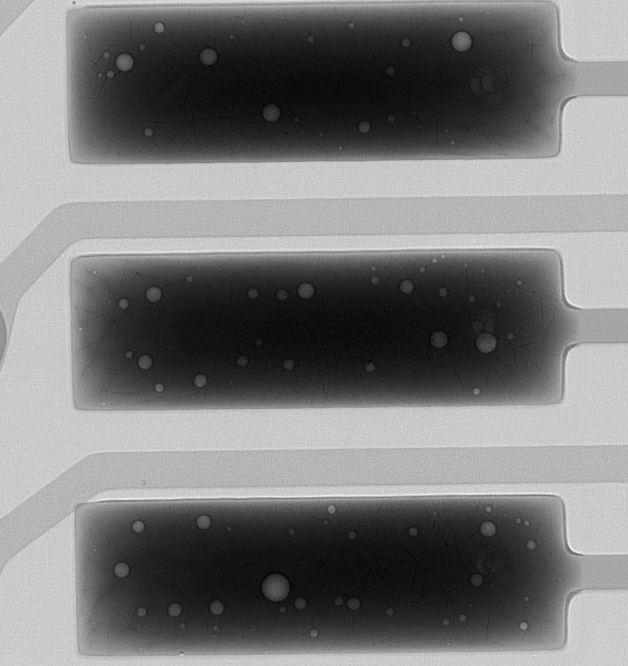
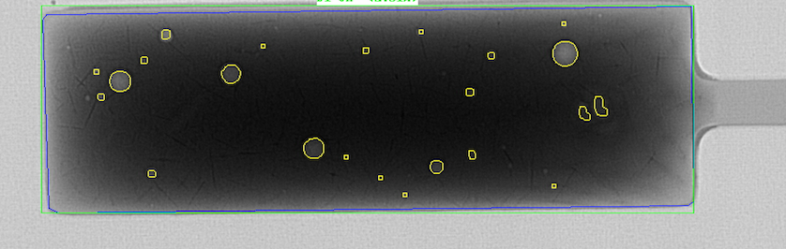
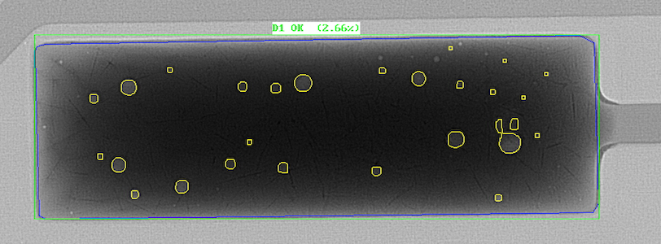
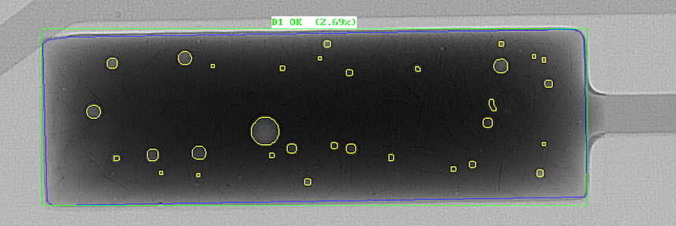
Example of void
Raw Image
Result image

Slide 7
BGA Defect (Ball Grid Array)
Count number of full balls - 25pt
Annotate each ball - 75pt
Bonus
Defect % in each ball : find out the voids in each ball = (total void area/ total area of the ball )*100
Annotate voids inside each ball

Slide 8

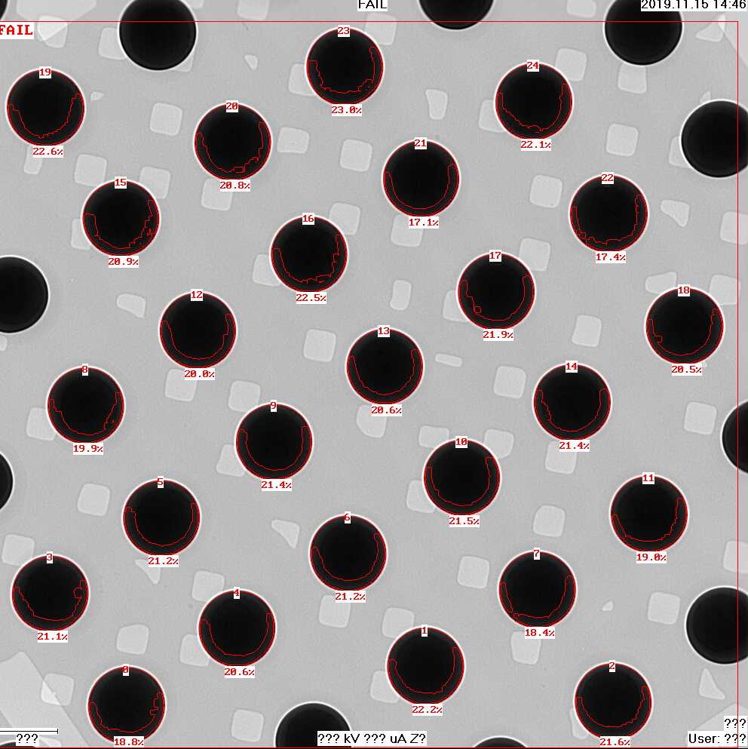
Example of BGA
Raw Image
Result image

Slide 9
Wire Sweep
Count the number of wires- 25pt
Annotate all the wire – 75pt
Bonus
Length of each wires - 10pt

Slide 10
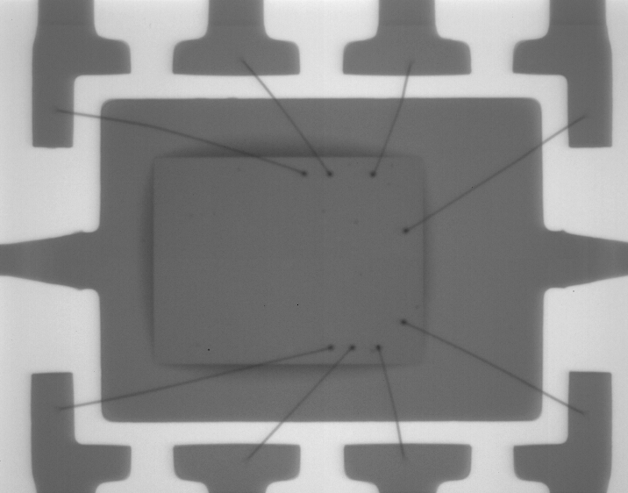
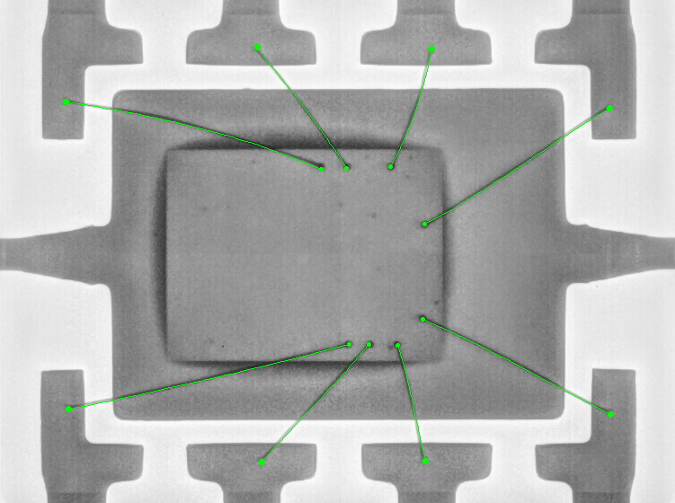
Example of Wire sweep
Raw Image
Result image

Slide 11
Tie breaker
Performance of algorithm in terms of time.

Slide 12
ALL THE BEST…

